Slide 1
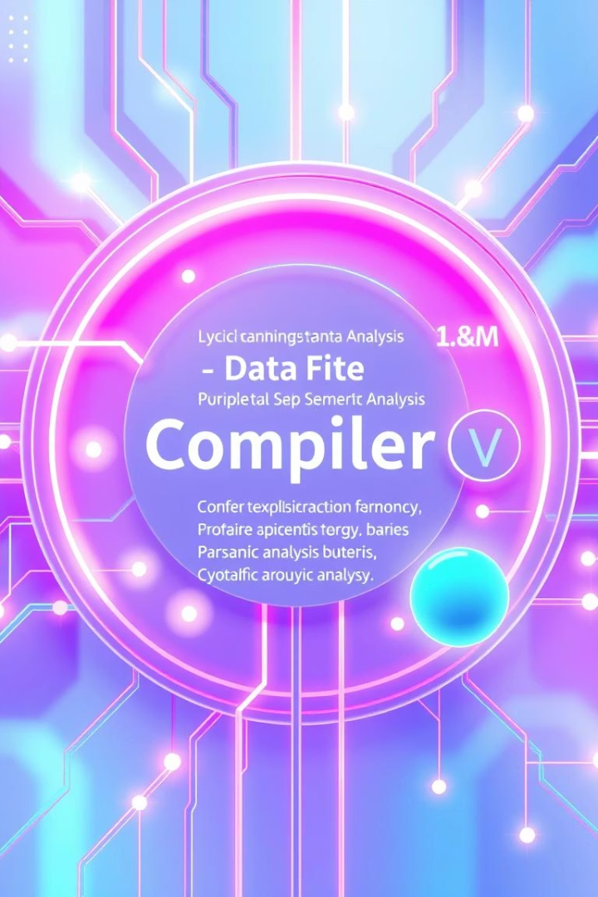
Lab 11
Syntax-Directed Translation for Semantic Analysis

Slide 2
Understanding Semantic Analysis
Definition
Key Functions
Semantic analysis, also known as context-sensitive analysis, is a crucial phase in compiler construction. It typically occurs after parsing and focuses on gathering necessary semantic information from the source code.
Type checking: Verifying type compatibility in expressions and assignments.
Declaration checks: Ensuring variables are declared before use.
This phase ensures that the syntax structure of the program carries meaning, addressing aspects impossible to describe in Extended Backus-Naur Form (EBNF) and thus not easily detected during parsing.
Meaning interpretation: Assigning meaning to tokens and syntax structures.

Slide 3
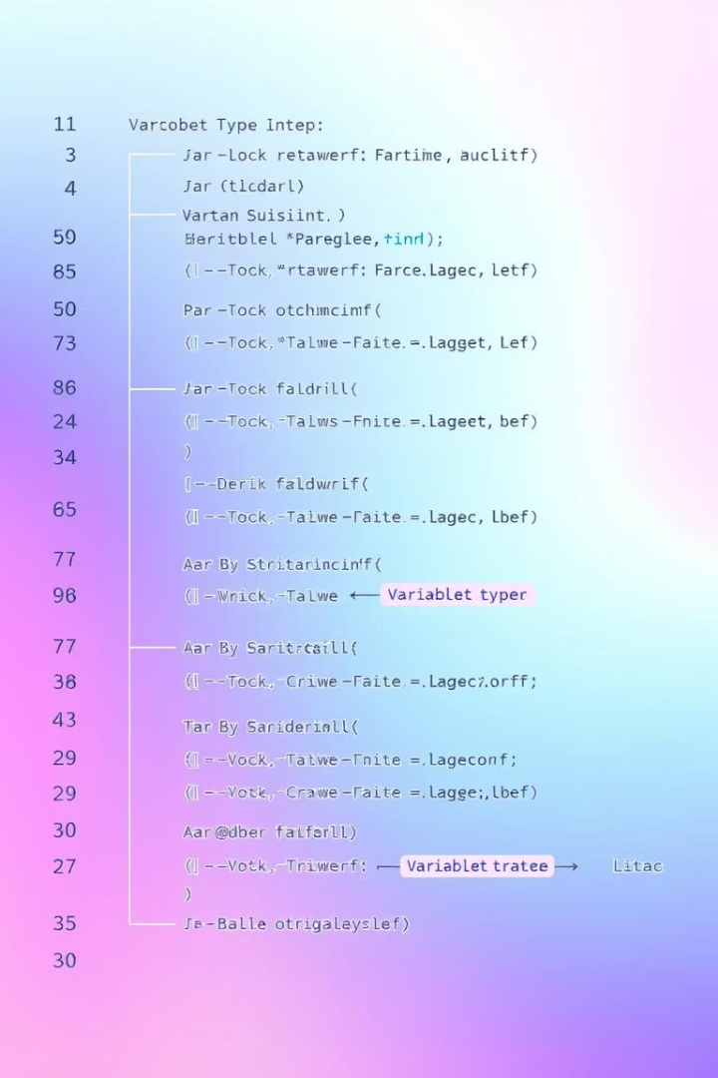
CFG + Semantic Rules = Syntax-Directed Definitions
The semantics of a language provide meaning to its constructs, such as tokens and syntax structure. Semantic analysis judges whether the syntax structure constructed in the source program derives any meaning or not. This is achieved by combining Context-Free Grammars (CFG) with semantic rules to form Syntax-Directed Definitions.
For example:
int a = "value";
should not issue an error in lexical and syntax analysis phase, as it is lexically and structurally correct, but it should generate a semantic error as the type of the assignment differs. These rules are set by the grammar of the language and evaluated in semantic analysis.

Slide 4

Lab Activity: Implementing Semantic Analyzer
The primary objective of this lab activity is to implement a semantic analyzer capable of checking type incompatibilities within a source program. This hands-on exercise will solidify understanding of how semantic rules are applied during compilation.
1
Initialize Final Array
2
Symbol Table Prerequisite
The first step involves initializing a finalArray with the input tokens from the source program.
A pre-implemented symbol table is essential, as the semantic analyzer relies on its information for variable lookups and type checks.
3
Variable Regex
A regular expression is used to identify valid variable names within the input.

Slide 5
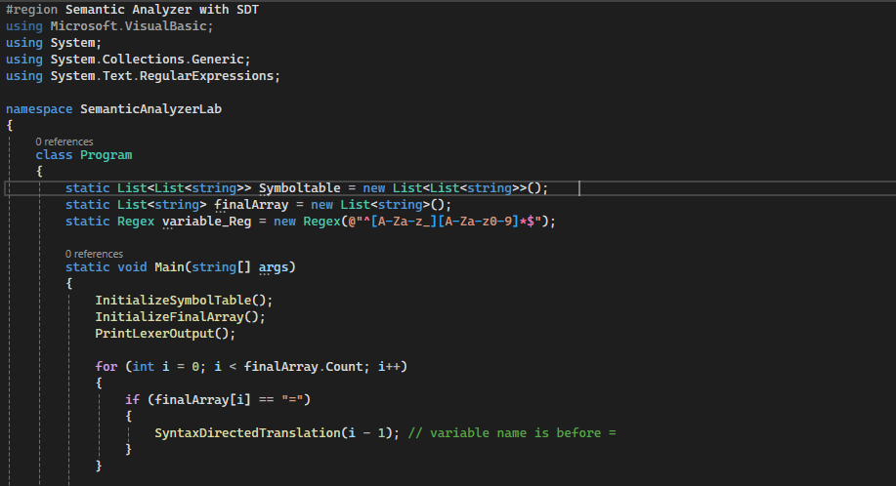
Code:

Slide 6
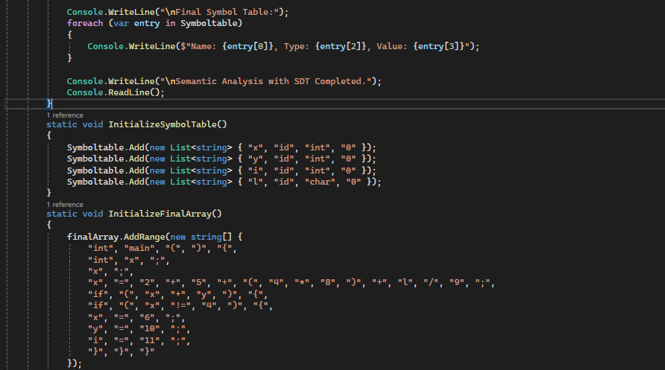

Slide 7
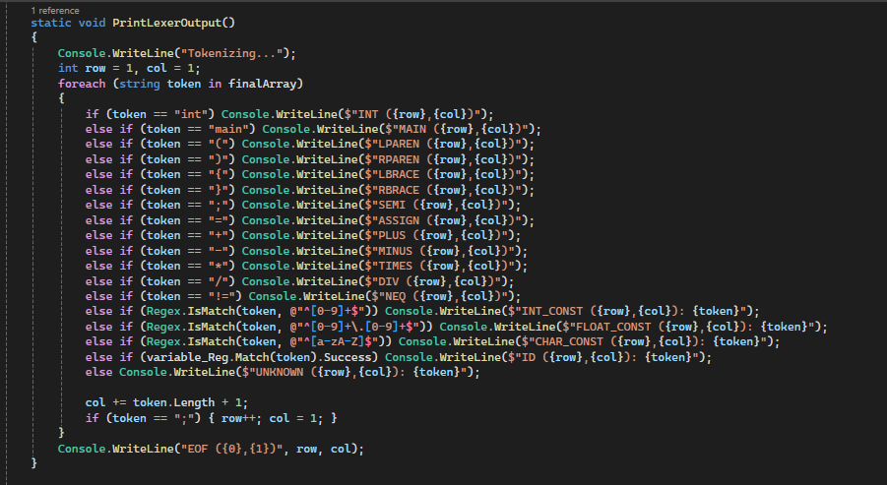

Slide 8
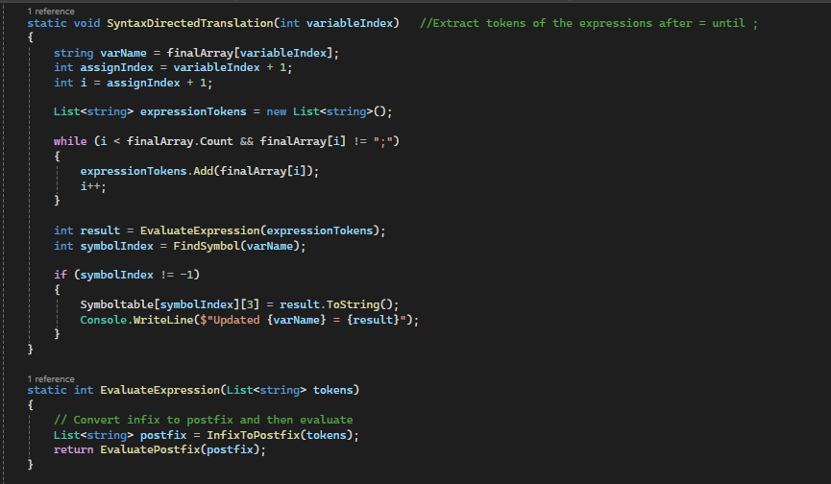

Slide 9
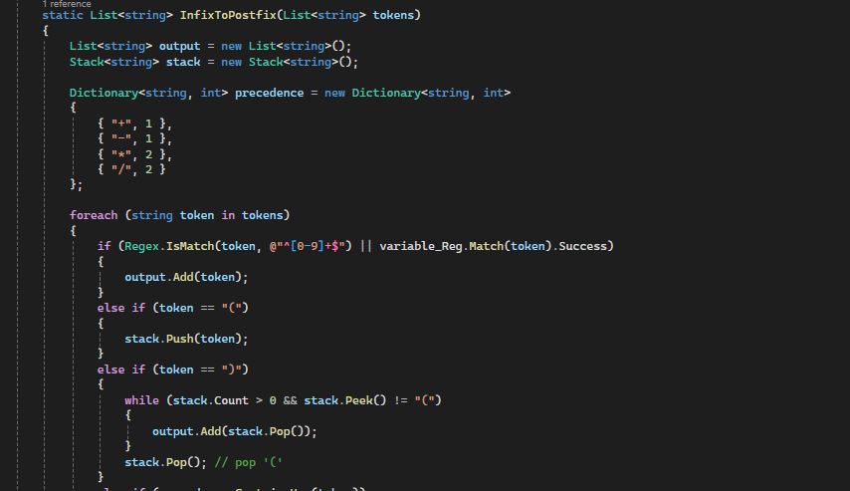

Slide 10
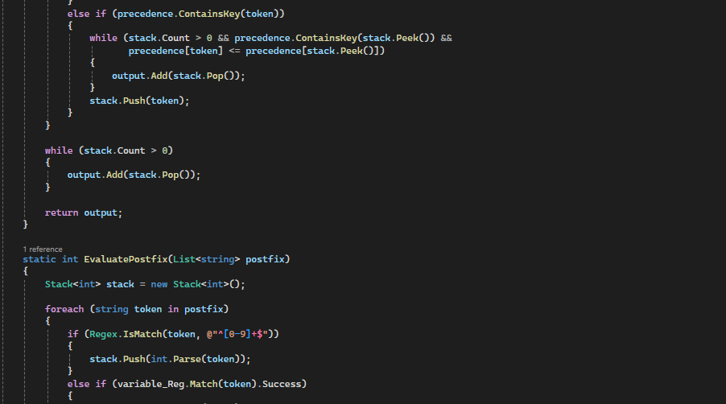

Slide 11
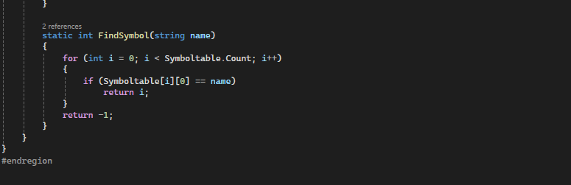

Slide 12
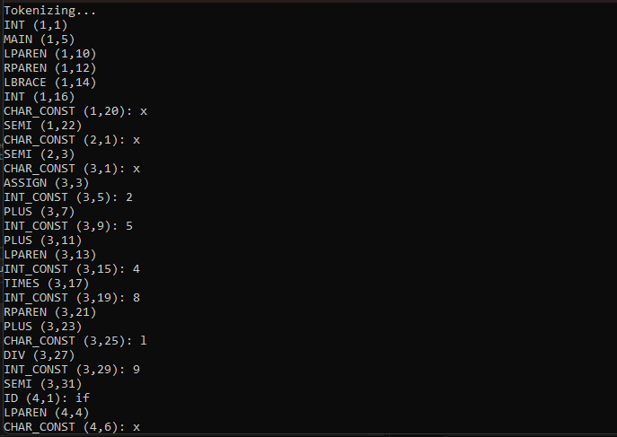

Slide 13
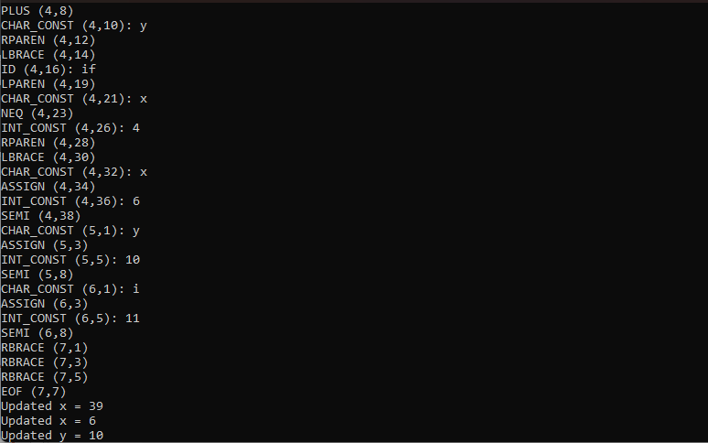

Slide 14
